Slide 1
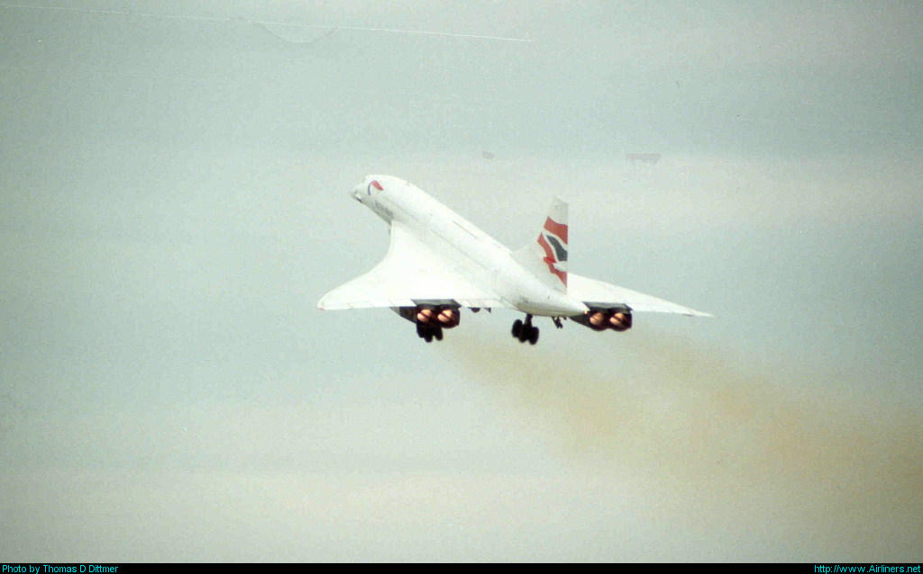
My Favorite Aircraft
Sammy Nassau
Notes:
Numbers indicate year of first flight!

Slide 2
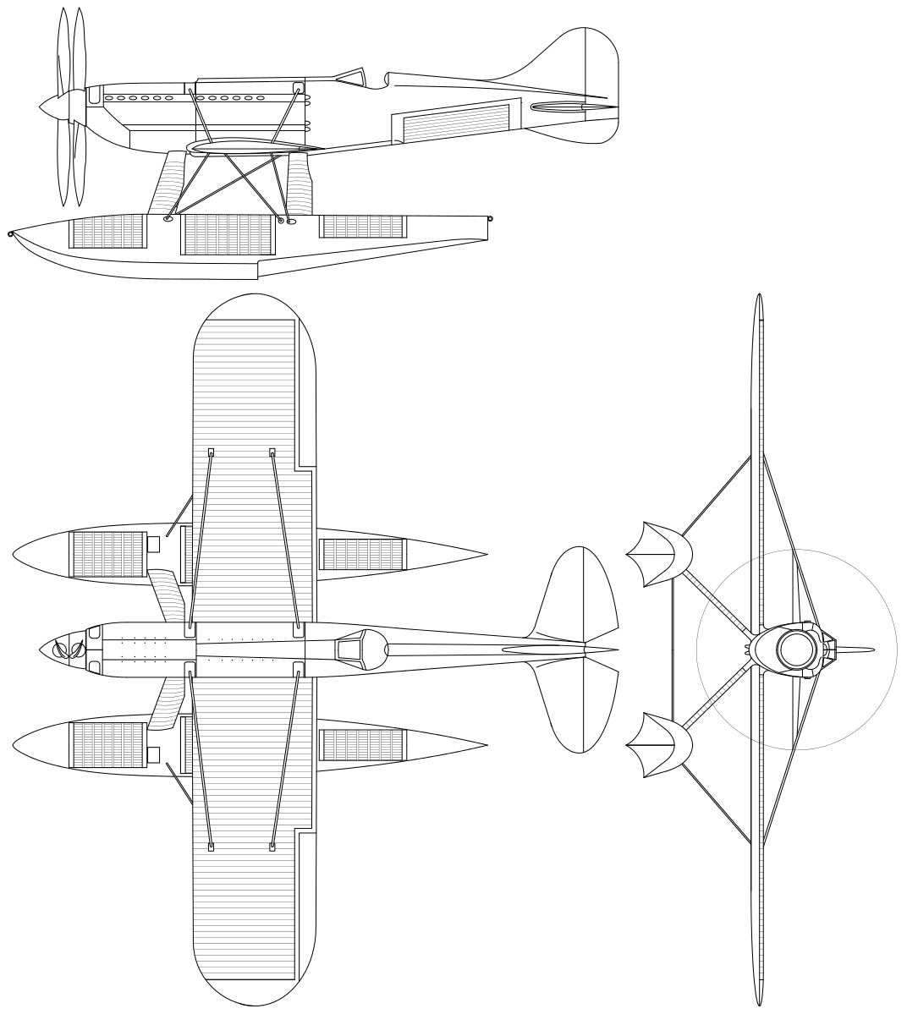
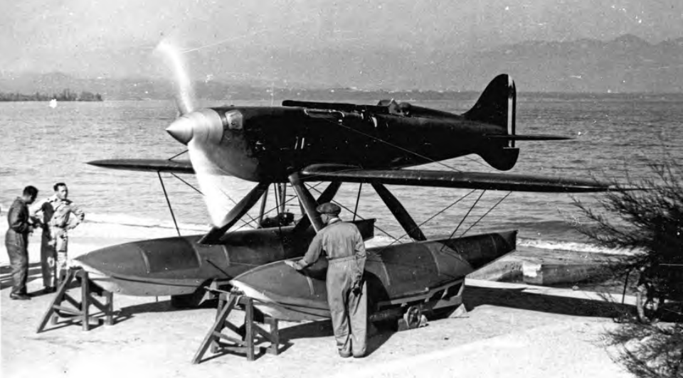
Macchi MC.72 (1931)
Notes:
Current floatplane piston engine speed record (440 mph, 709 kmh), two two-bladed counter rotating props,

Slide 3
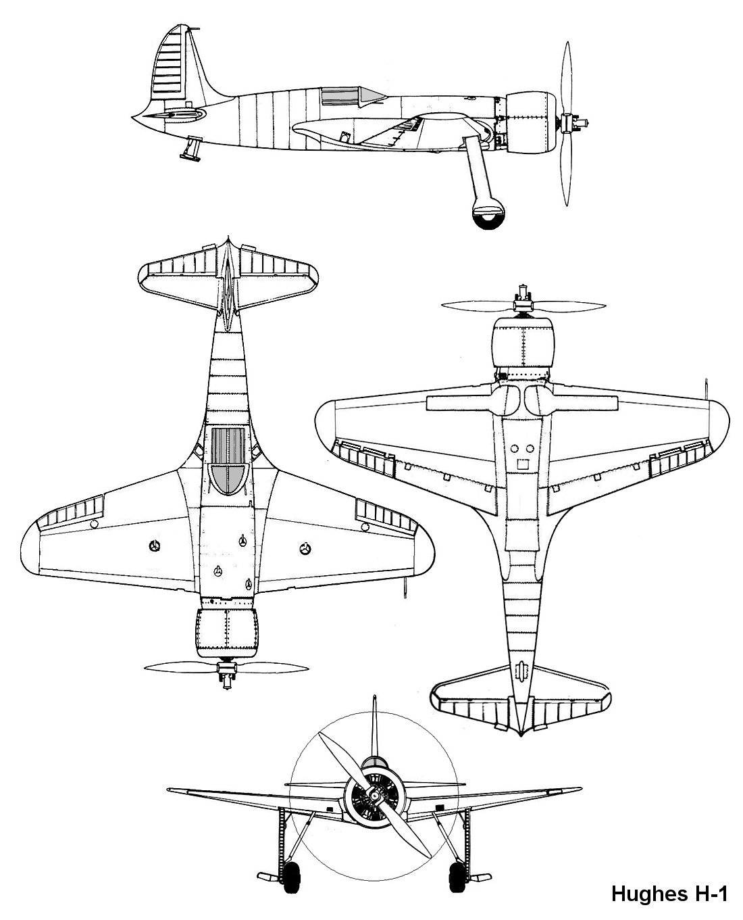
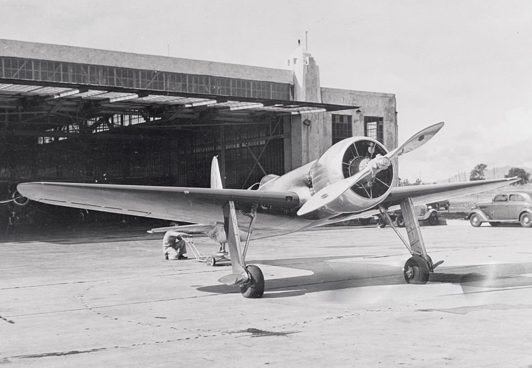
Hughes H-1(1935)

Slide 4
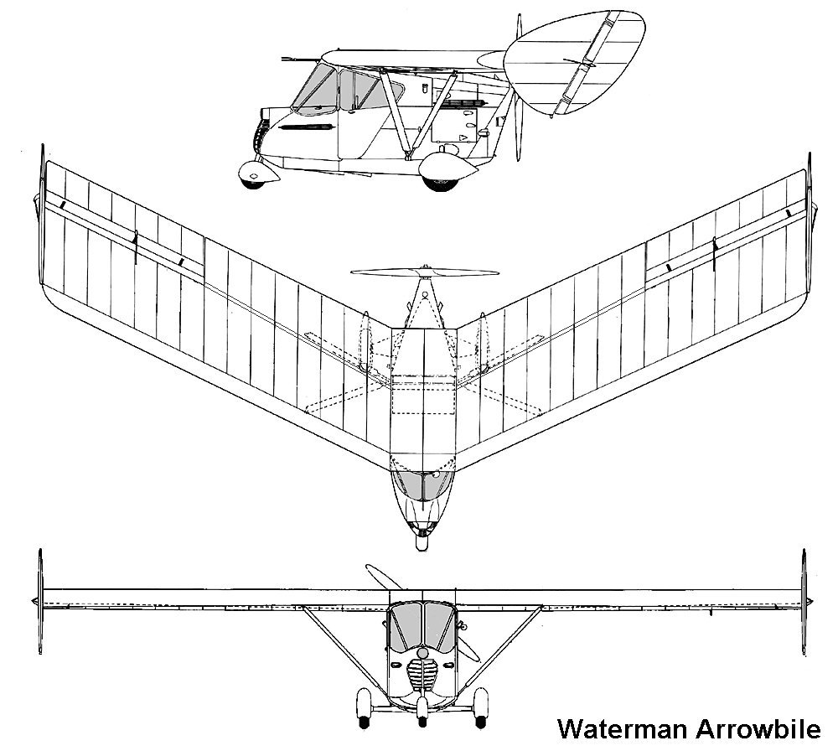
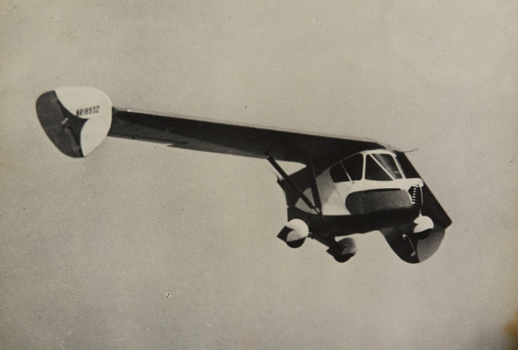
Waterman Arrowbile (1937)
Notes:
Flying car!

Slide 5
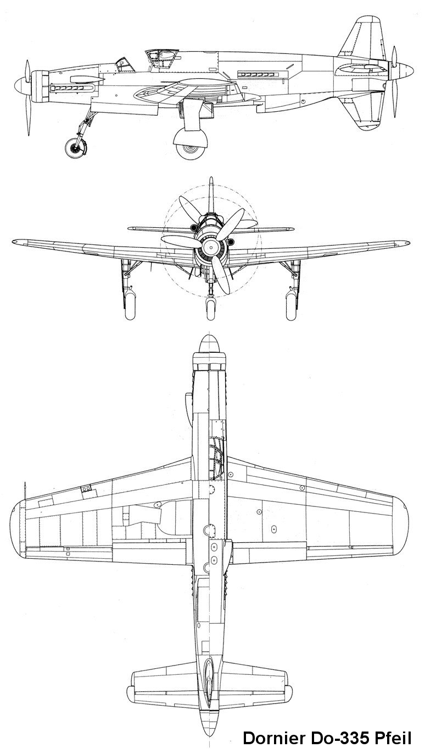
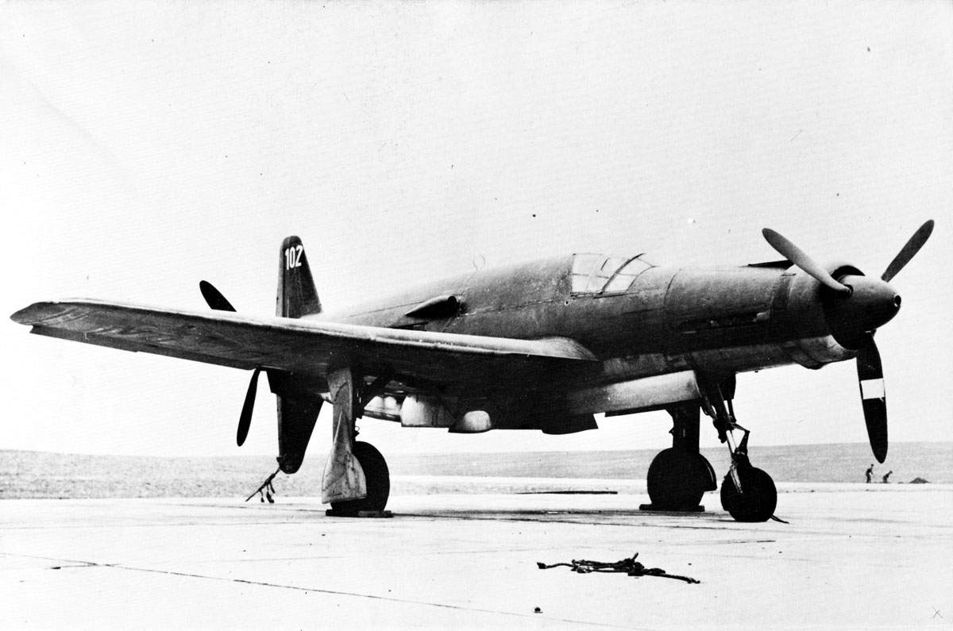
Dornier Do-335 (1943)

Slide 6
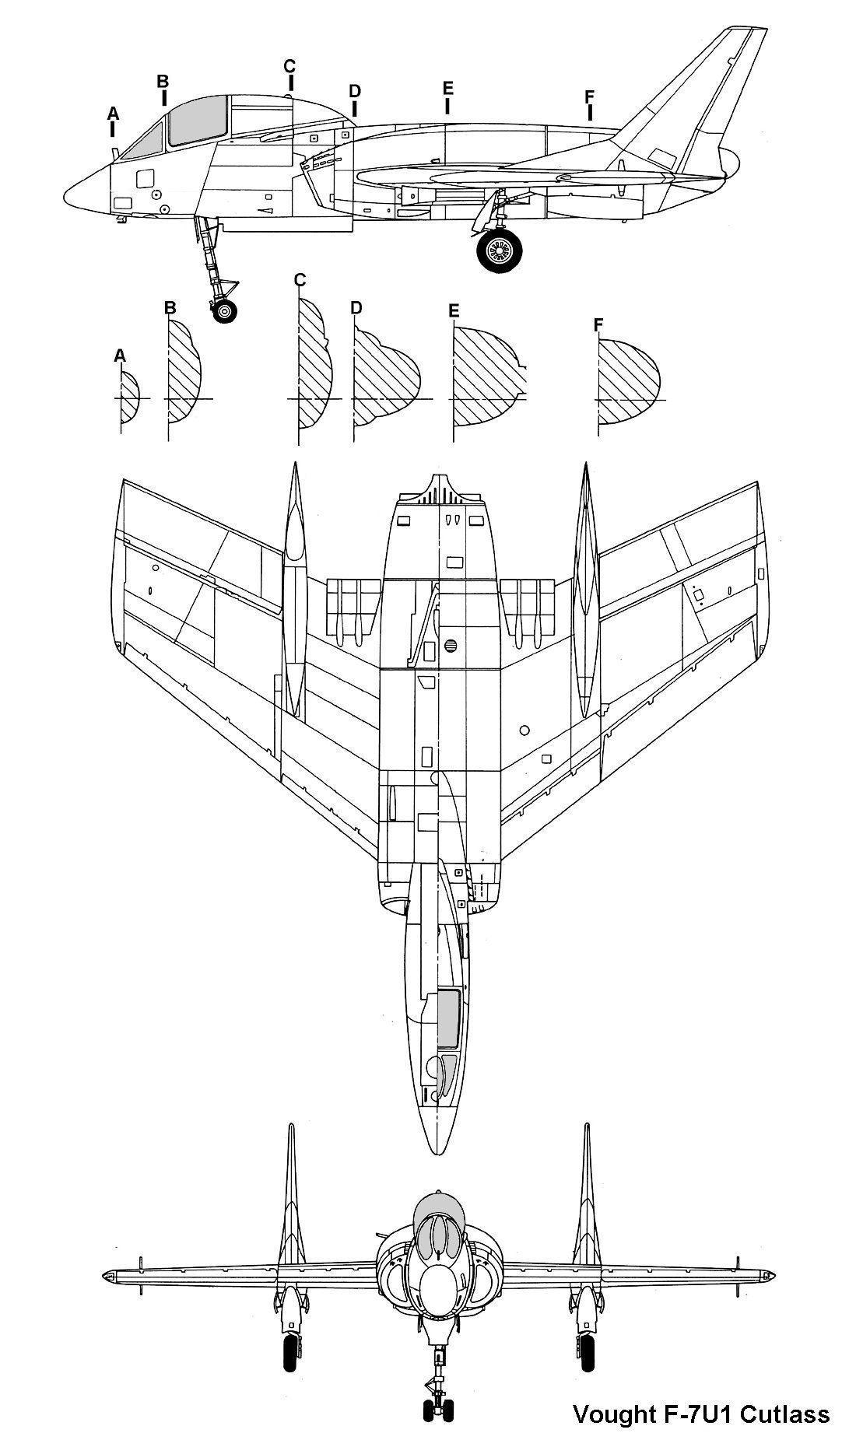
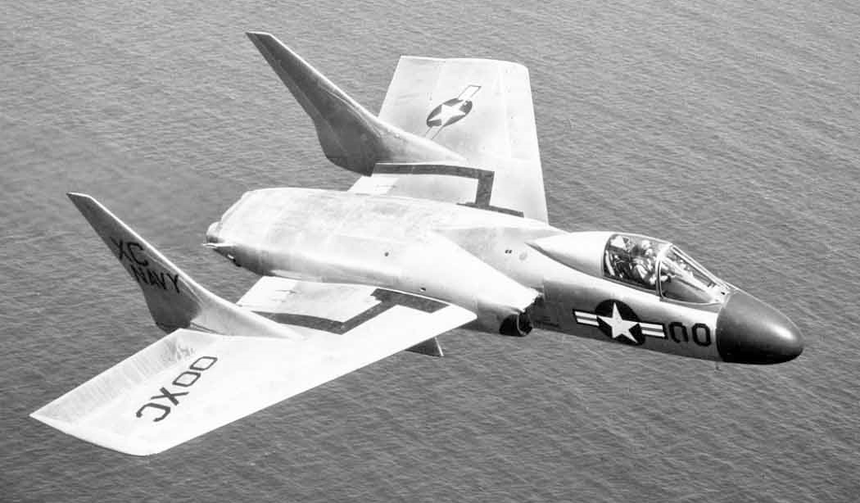
Vought F7U Cutlass (1948)

Slide 7
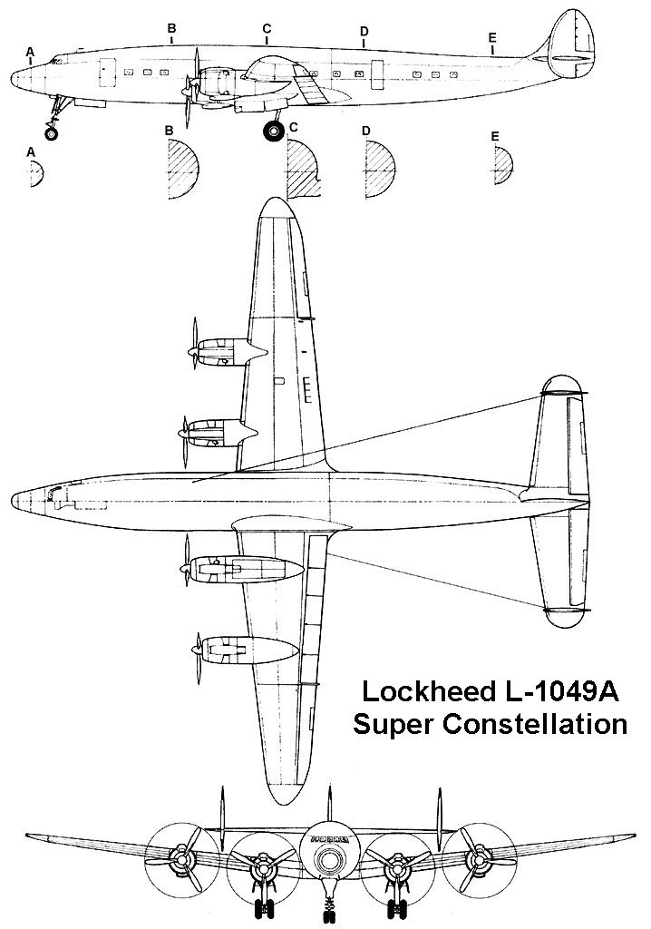
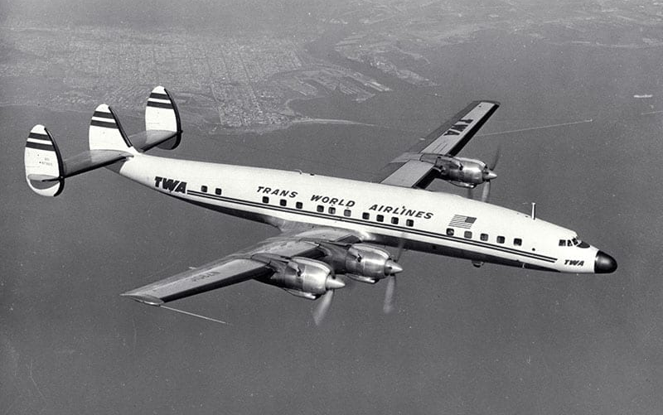
Lockheed L-1049A Super Constellation (1951)
Notes:
Constellation first flew in 1943

Slide 8
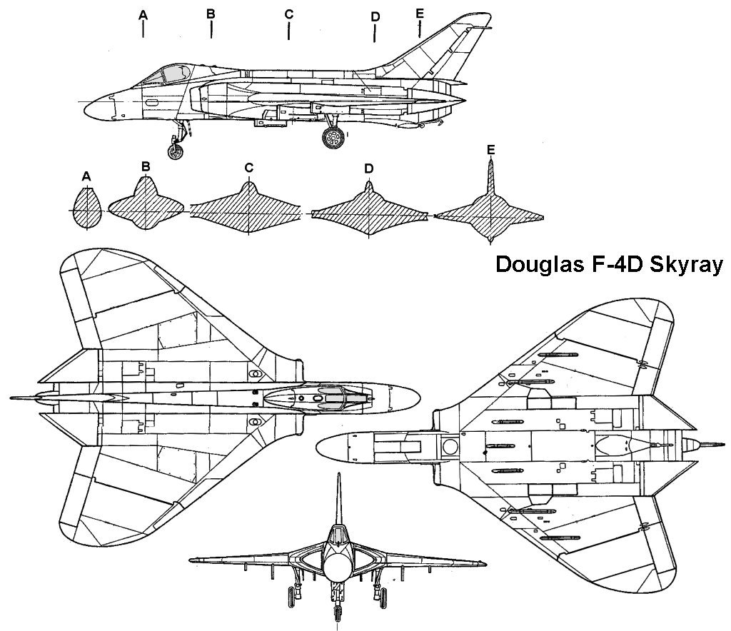
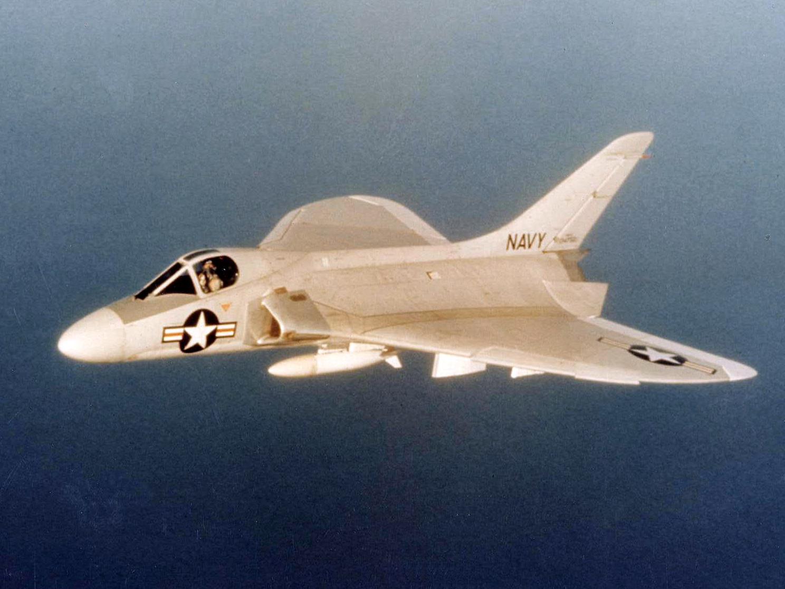
Douglas F4D Skyray (1951)

Slide 9
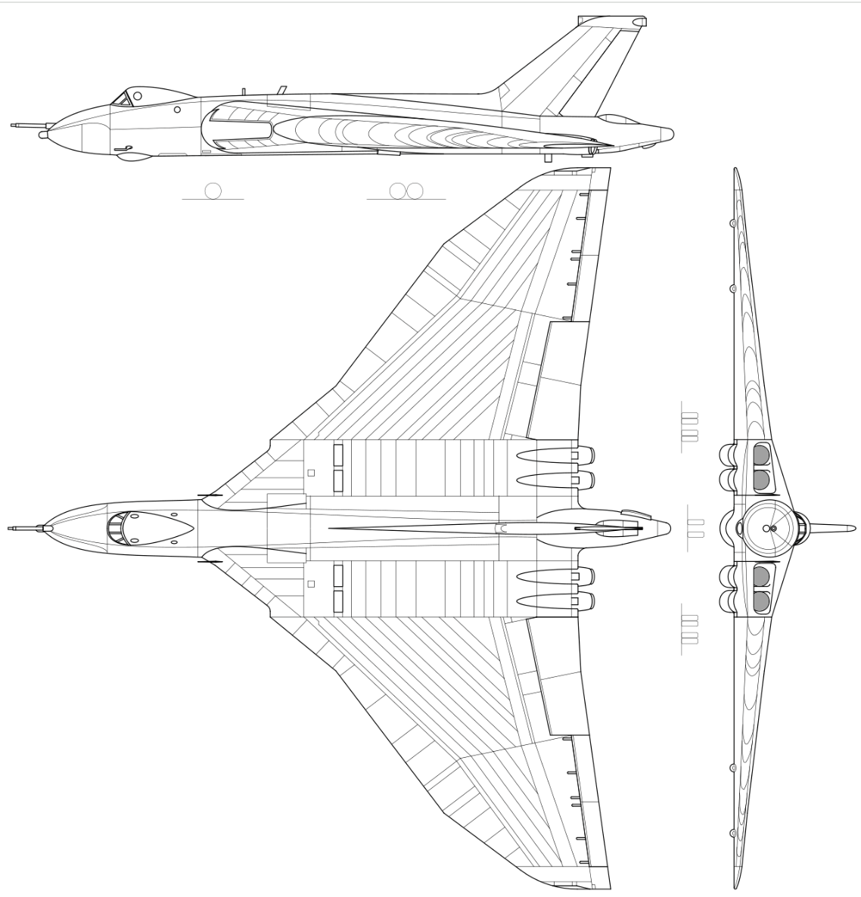
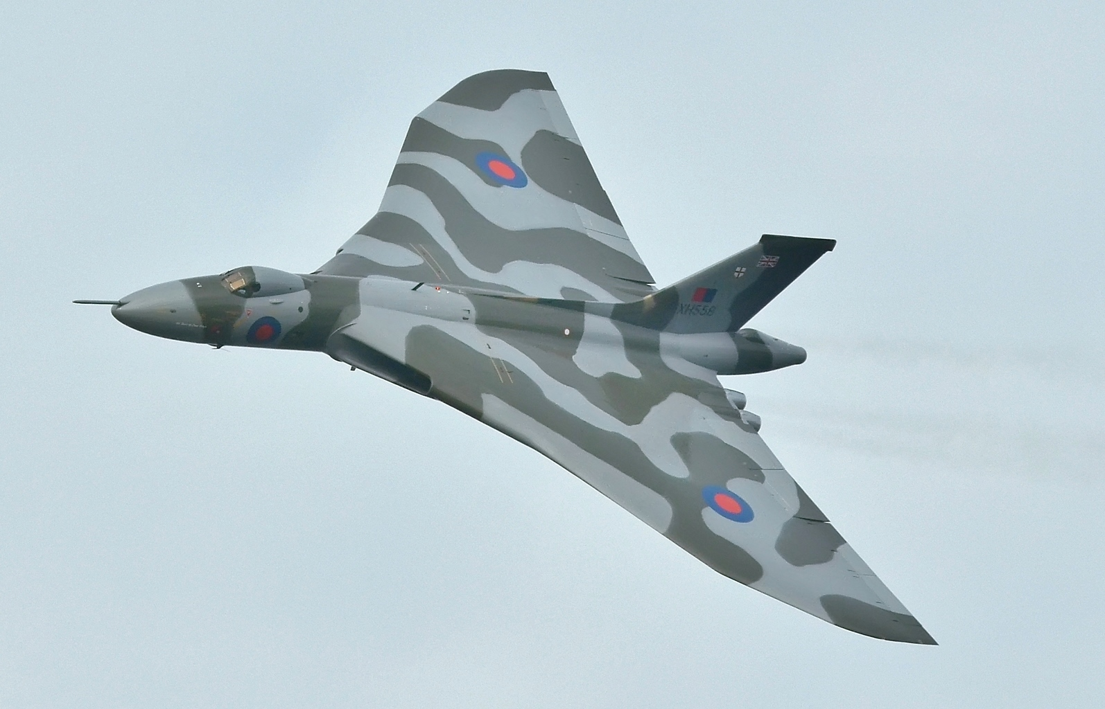
Avro Vulcan (1952)

Slide 10
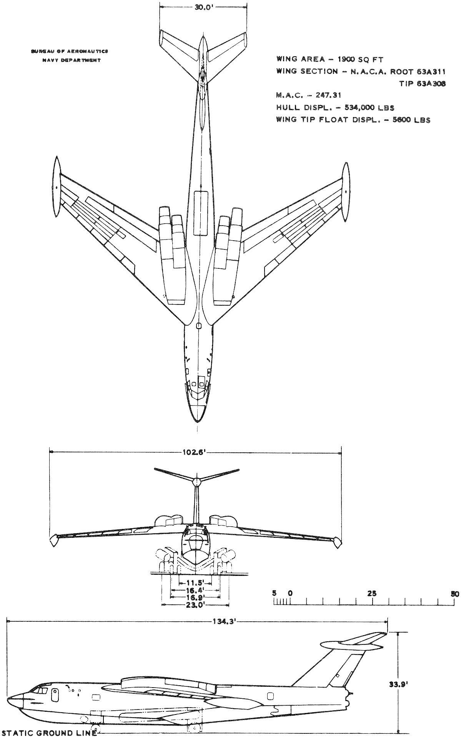
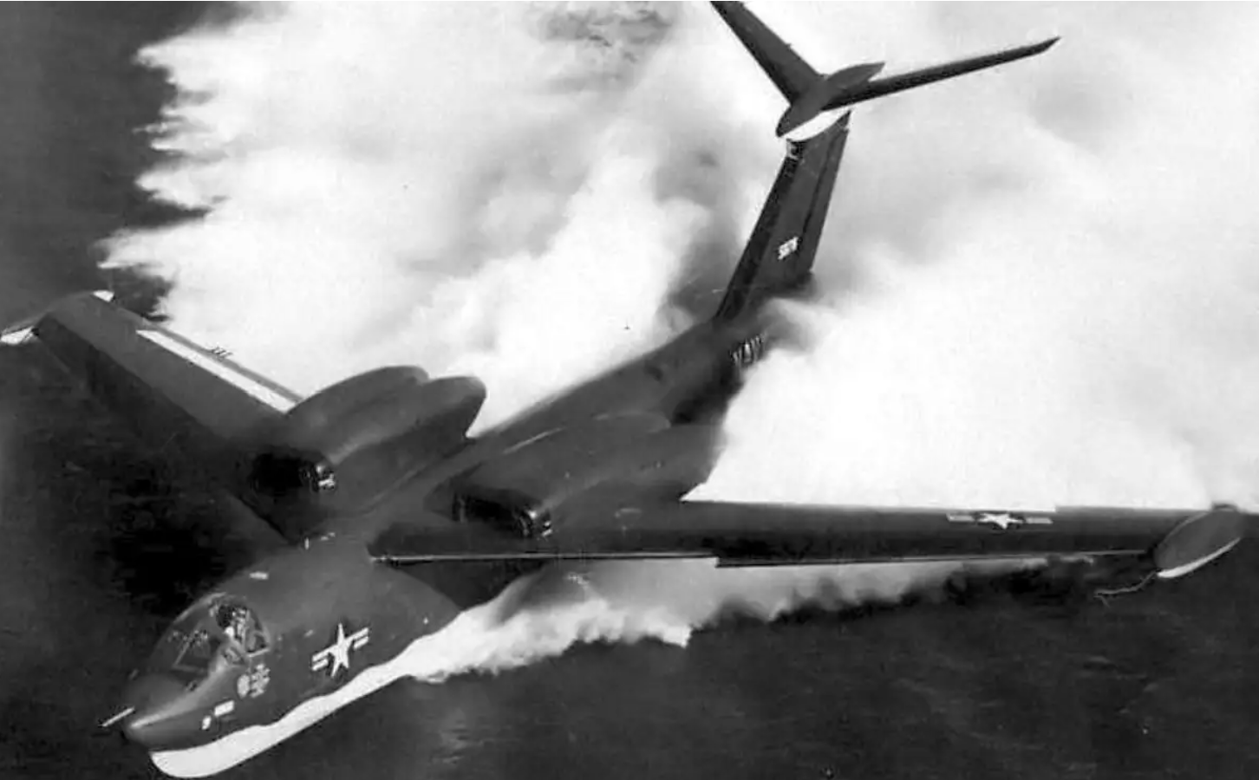
Martin P6M Seamaster (1955)

Slide 11
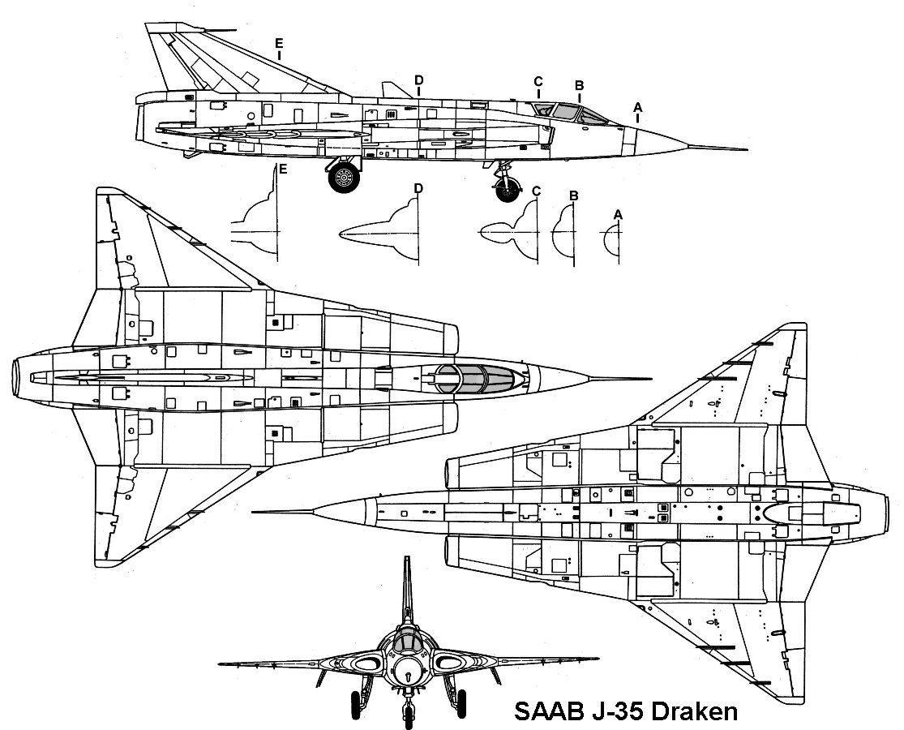
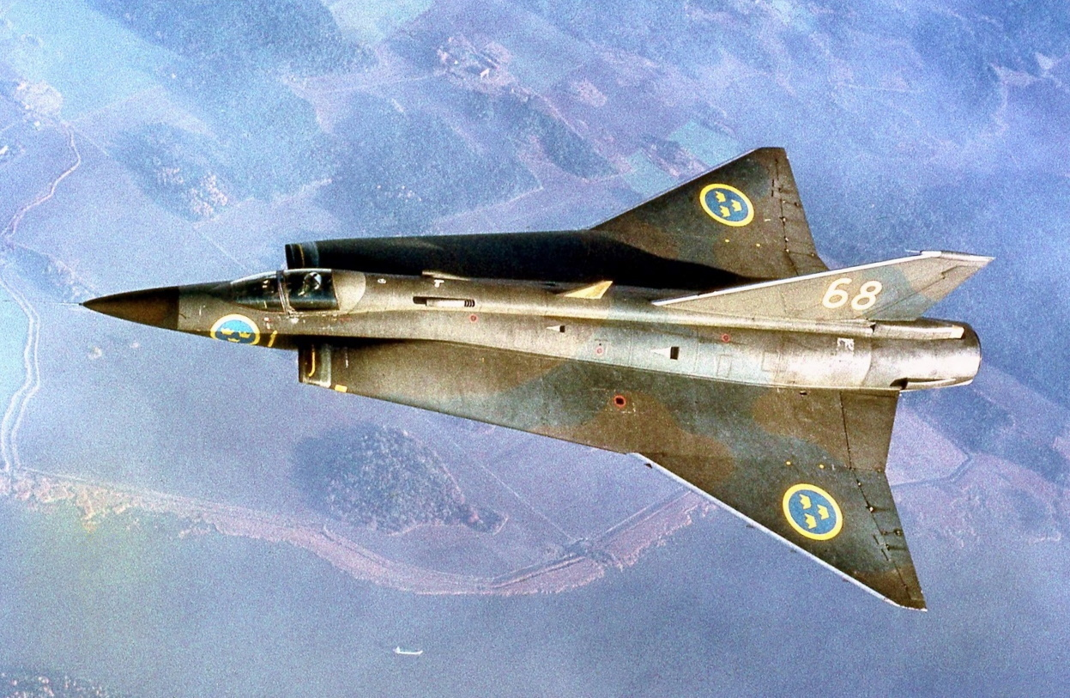
SAAB J35 Draken (1955)

Slide 12
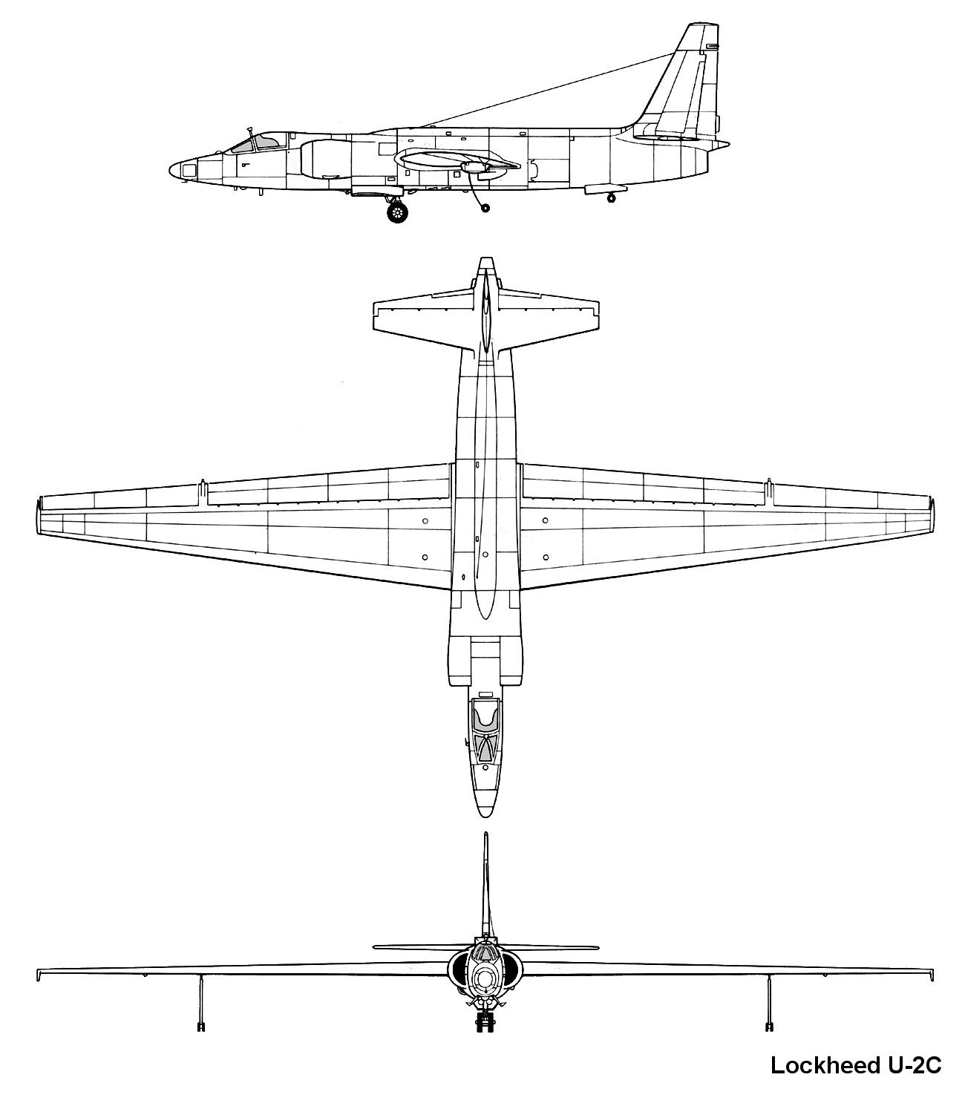
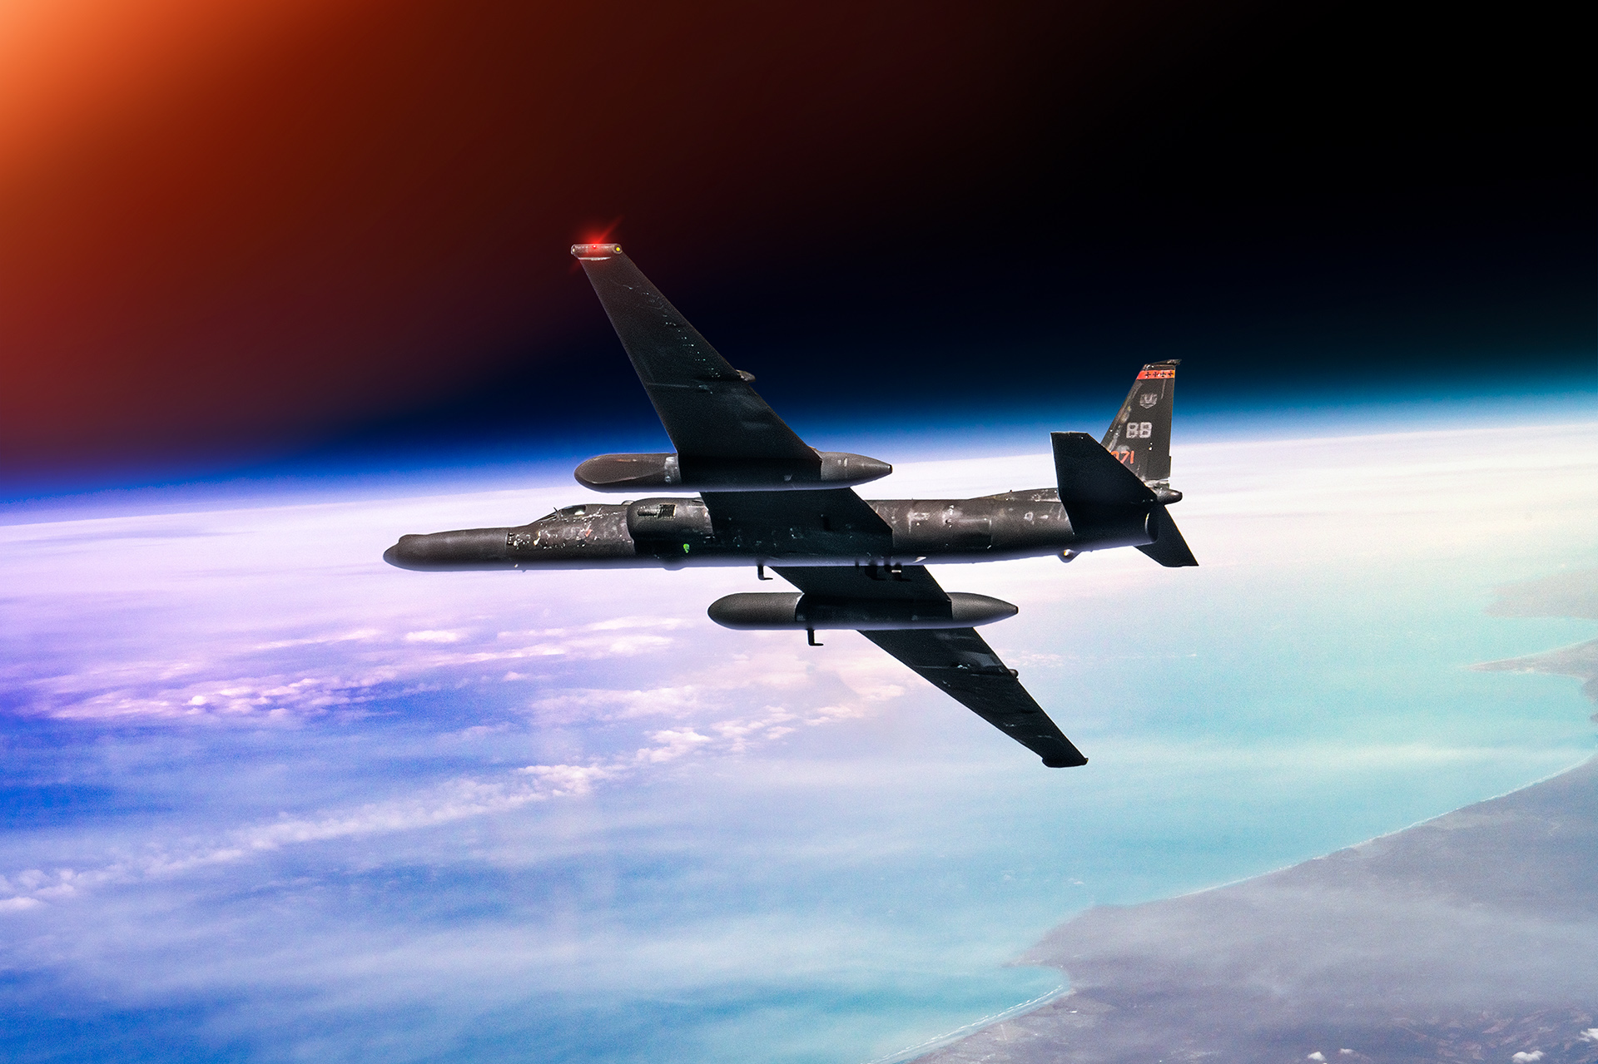
Lockheed U-2 (1955)

Slide 13
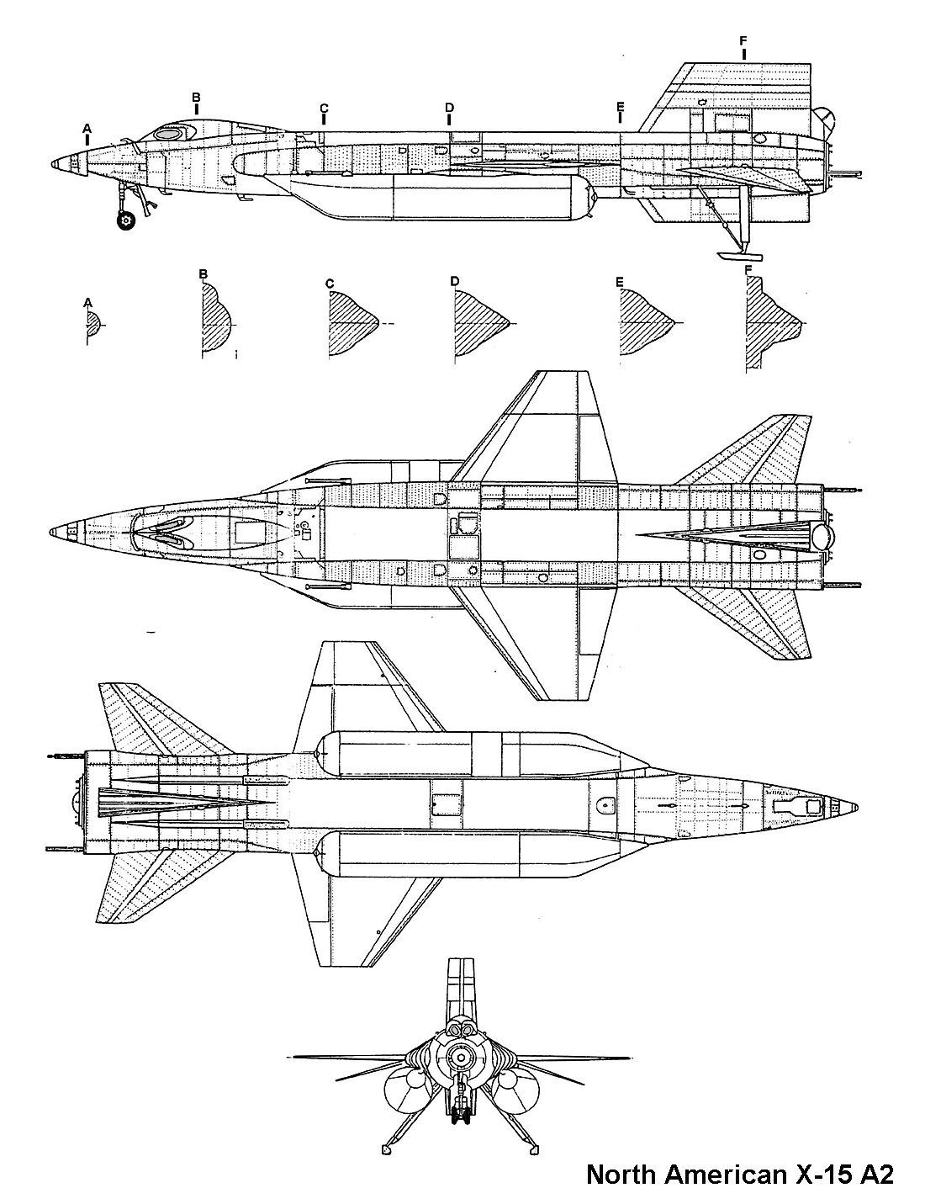
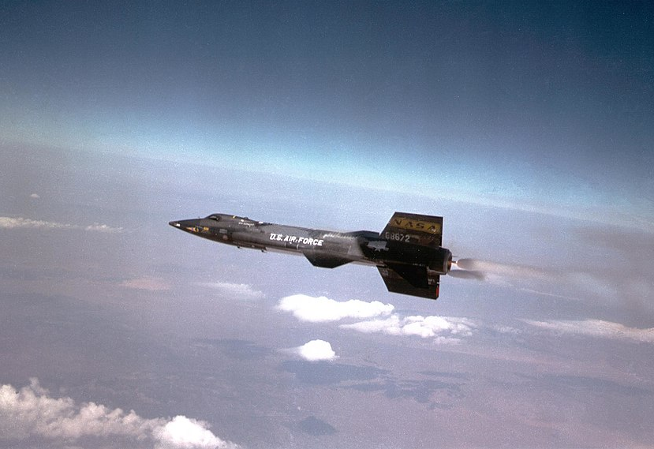
North American X-15 (1959)
Notes:
highest speed ever recorded by a crewed, powered aircraft at Mach 6.7 (4,520 miles per hour (7,274 km/h; 2,021 m/s) in 1968. Program pioneered blunt nose design for hypersonics (space shuttle)

Slide 14
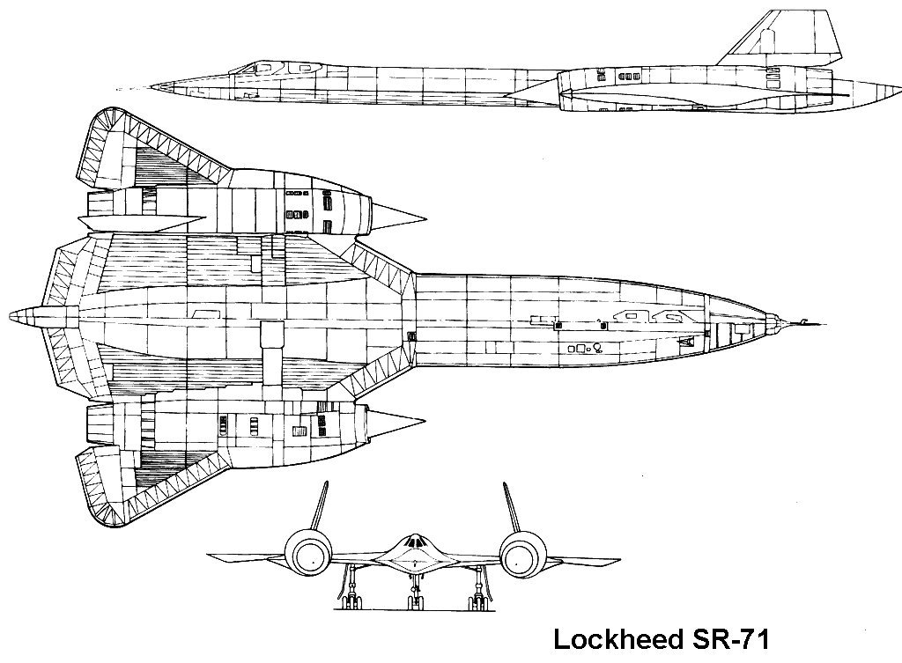
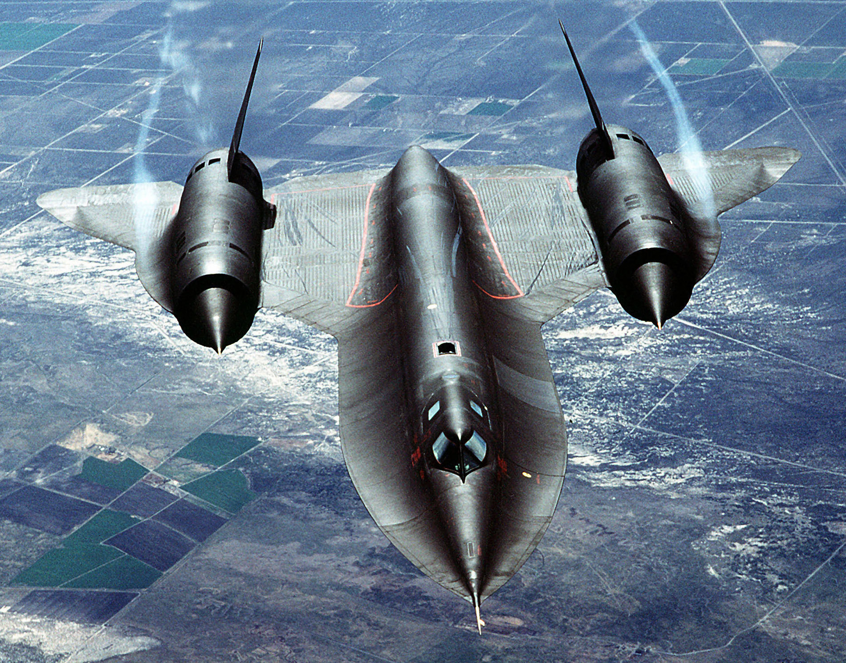
Lockheed SR-71(1964)
Notes:
A-12 first flew in 1962!

Slide 15
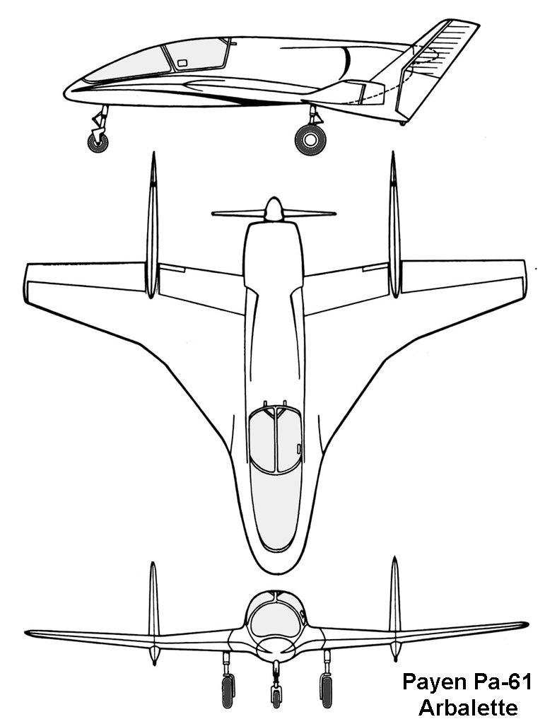
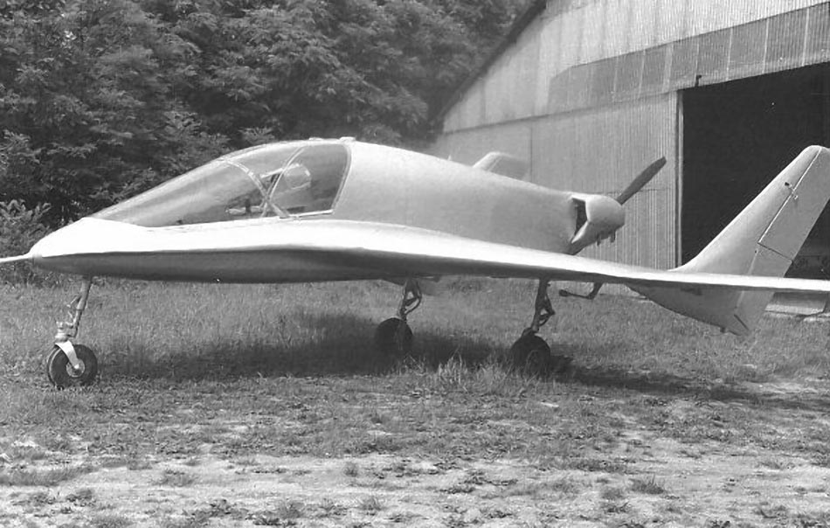
Payen Pa.61 Arbalète (1965)

Slide 16
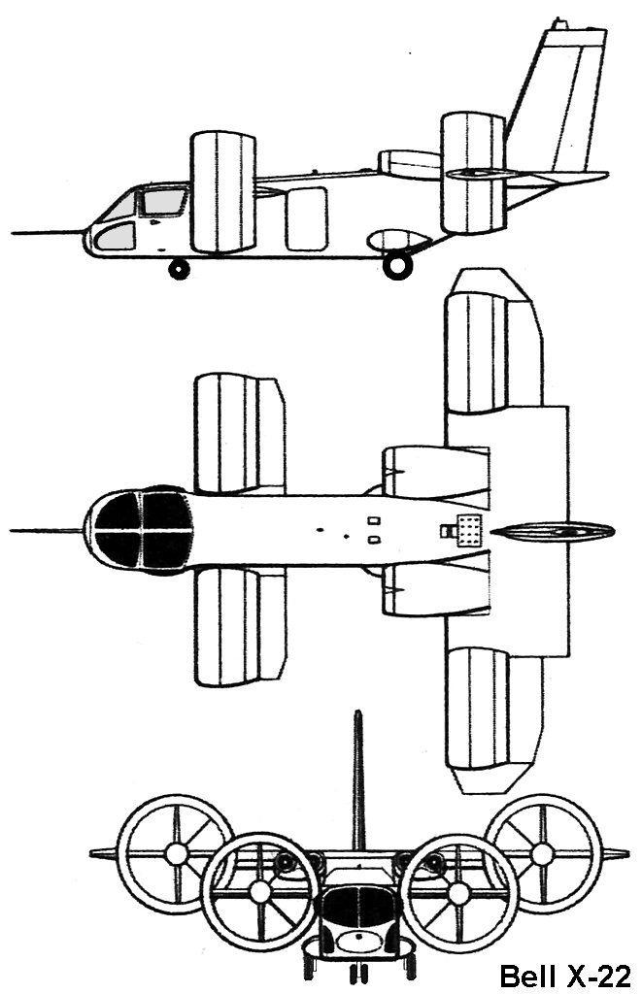
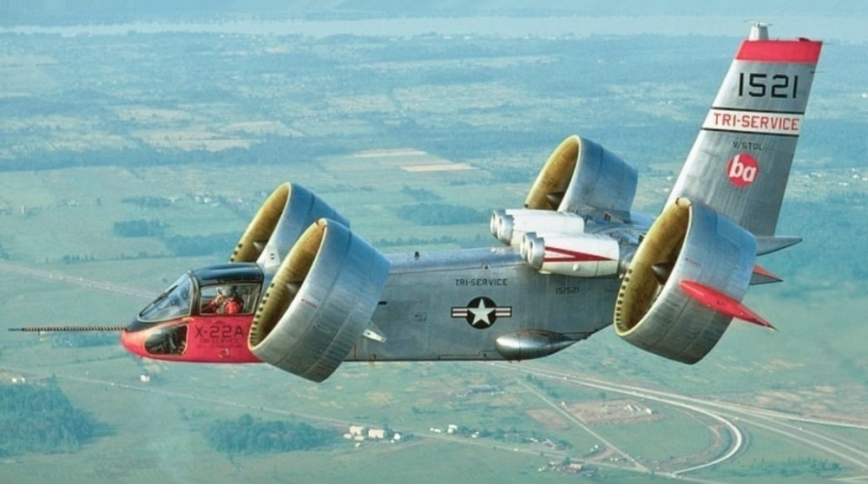
Bell X-22 (1966)

Slide 17
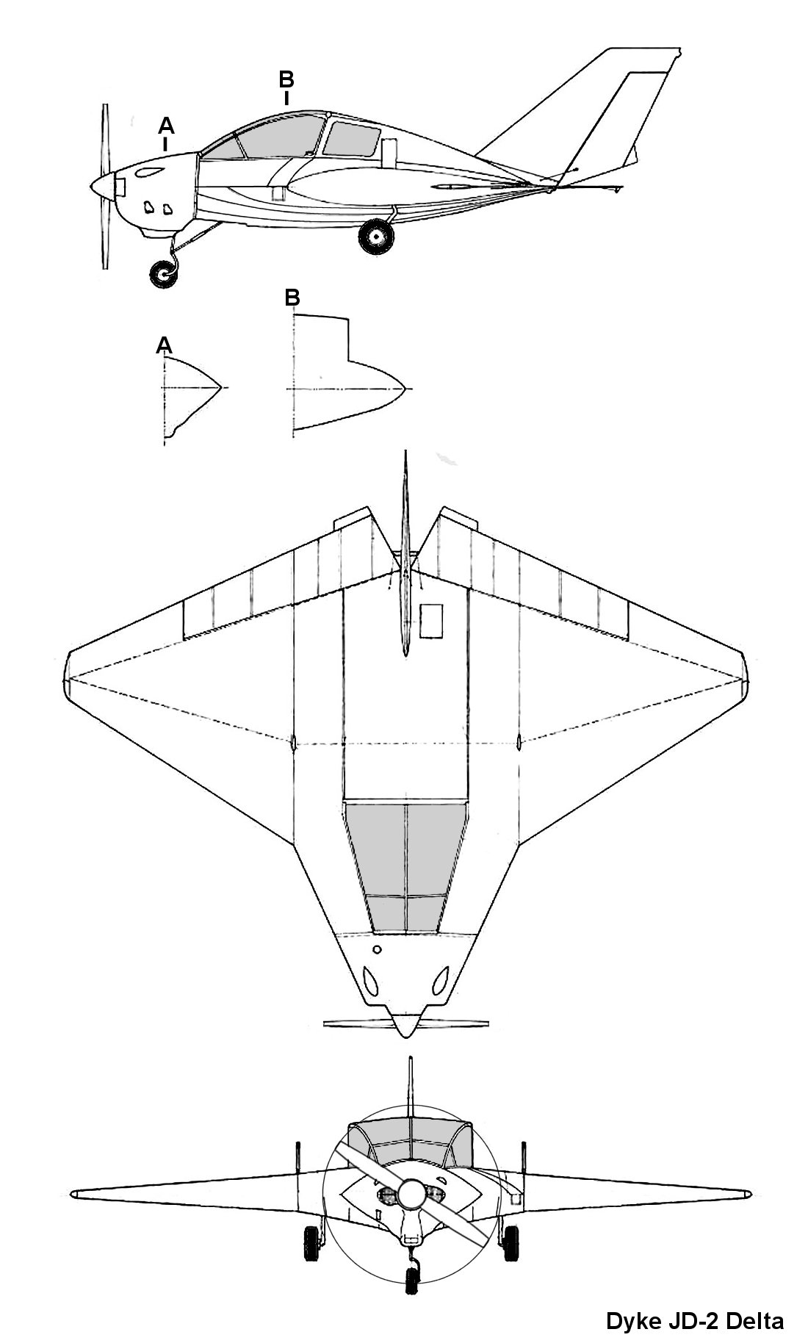
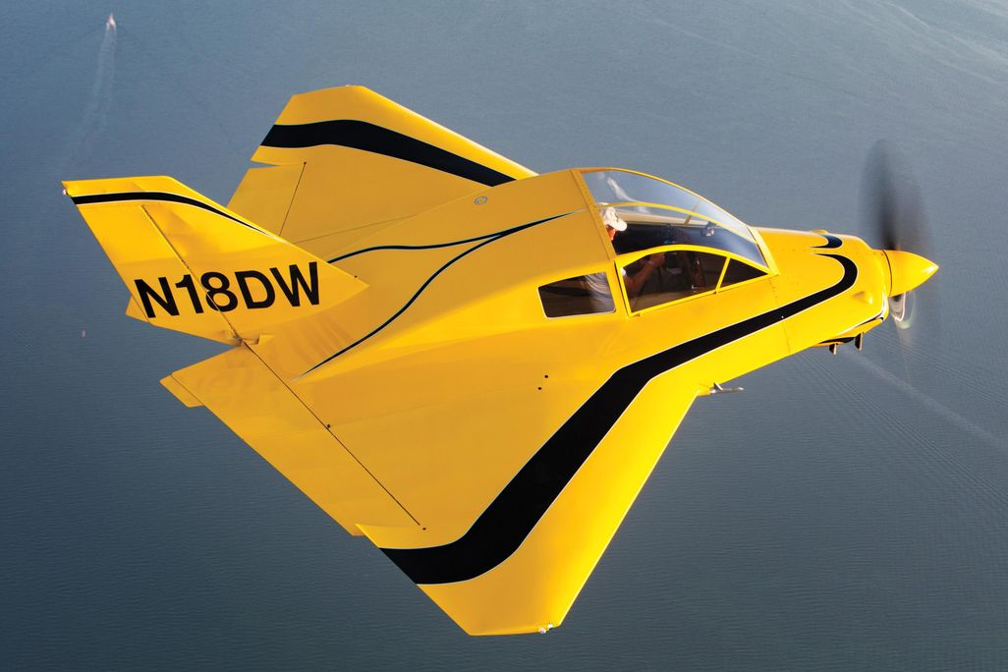
Dyke JD-2 Delta (1966)

Slide 18
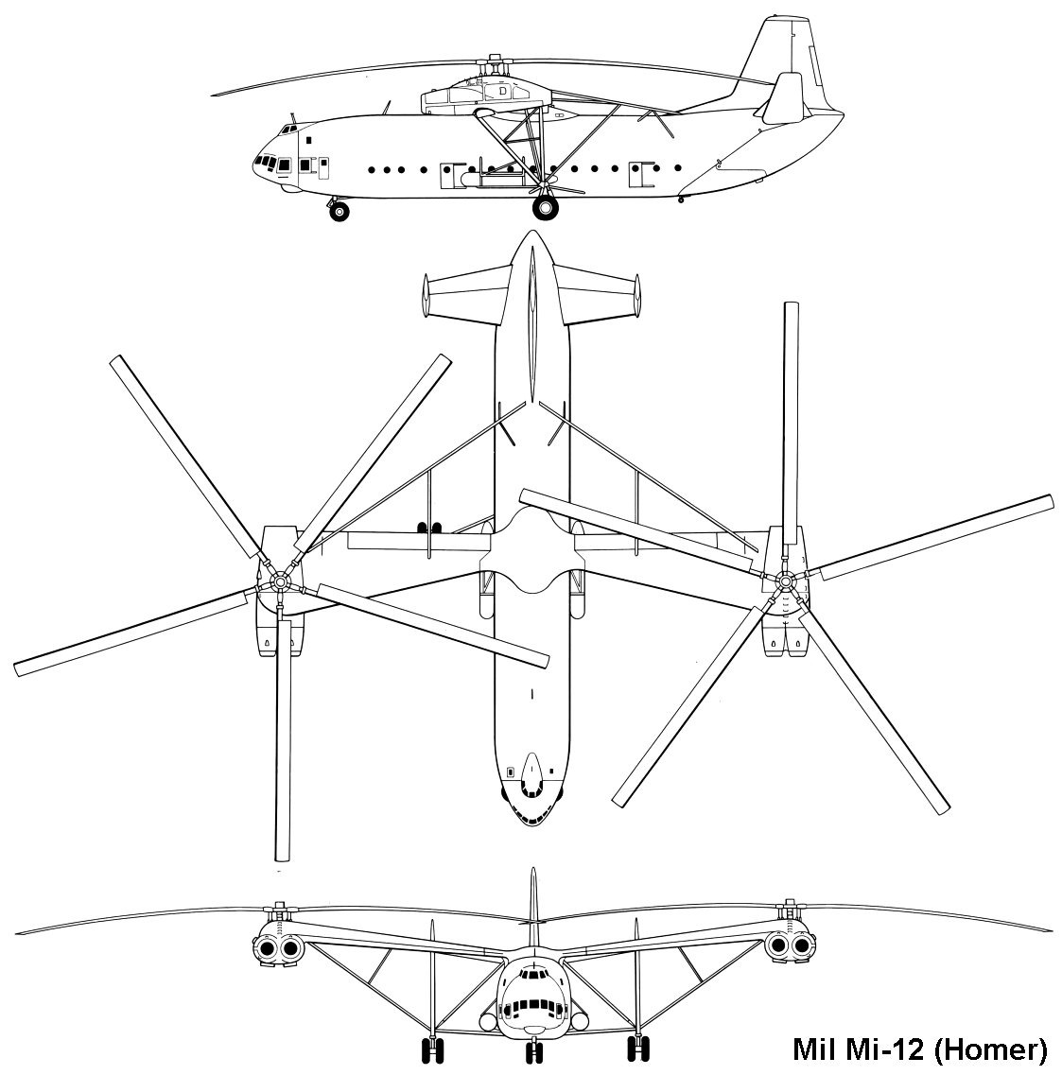
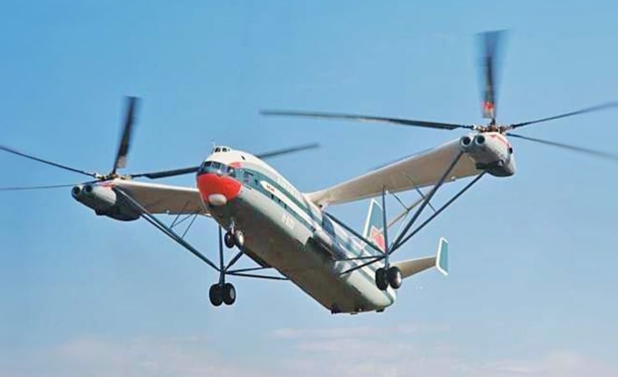
Mil Mi-12 (1968)
Notes:
largest helicopter ever built, 105,000 kg (231,485 lb) MGTOW!, unsuccessful 1967 flight,

Slide 19
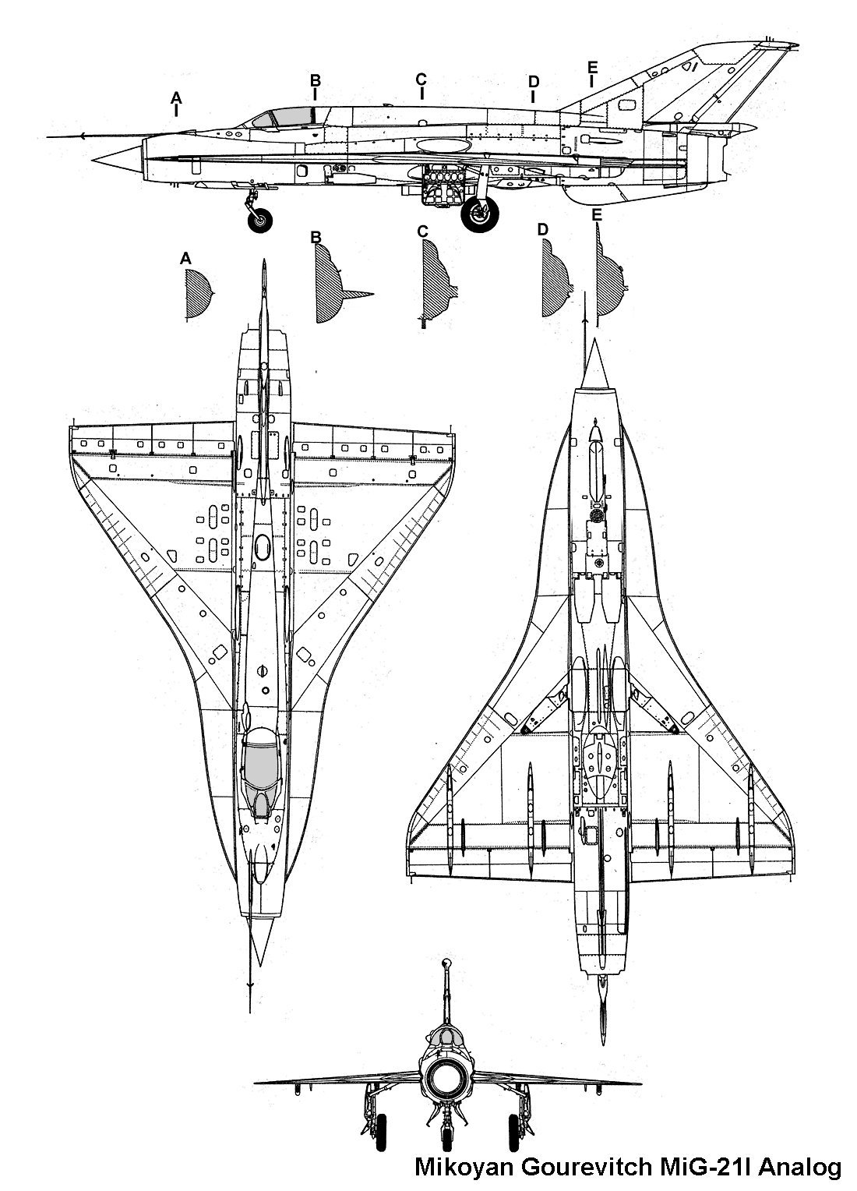
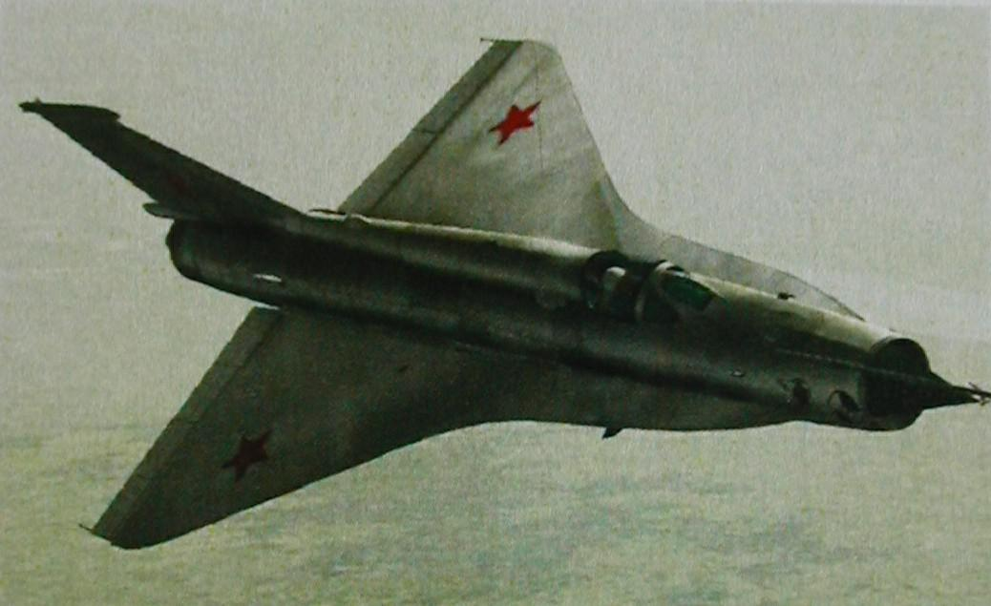
MiG-21I Analog (1968)
Notes:
Testbed for Tu-144 tailless delta wings

Slide 20
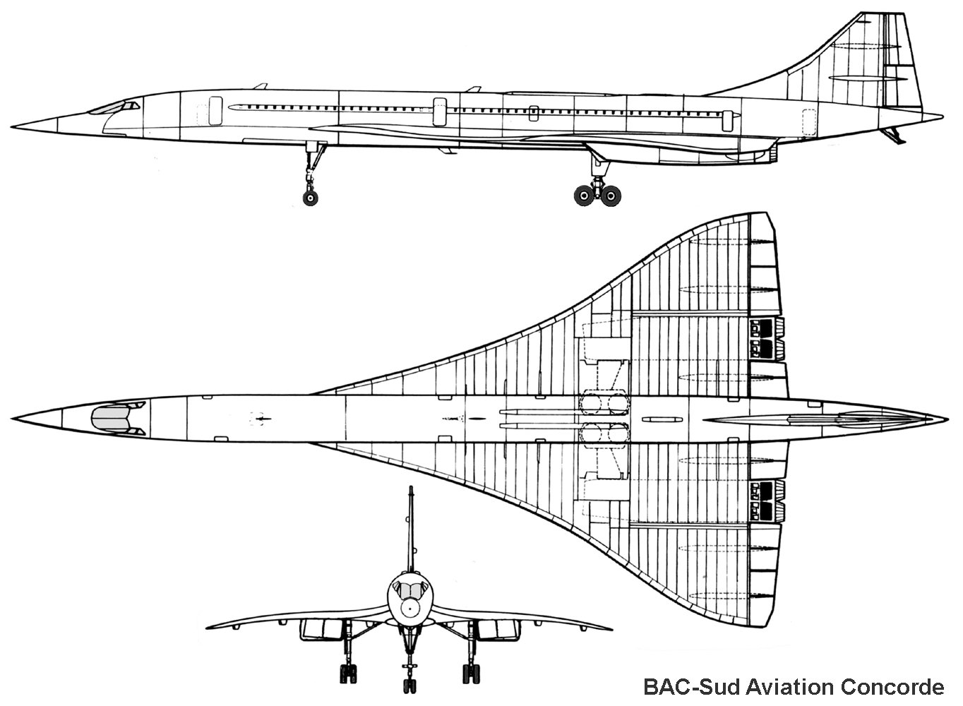
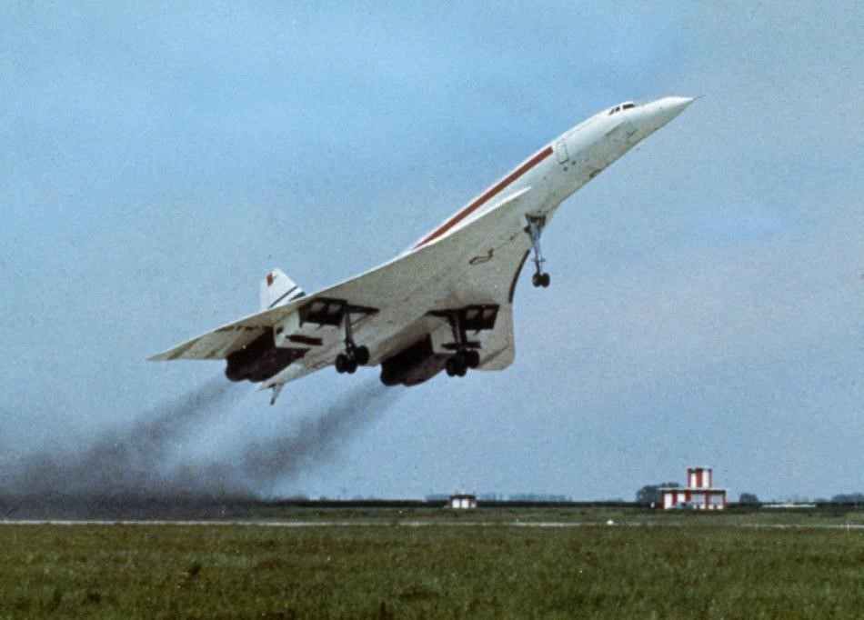
BAC-Sud Concorde (1969)

Slide 21
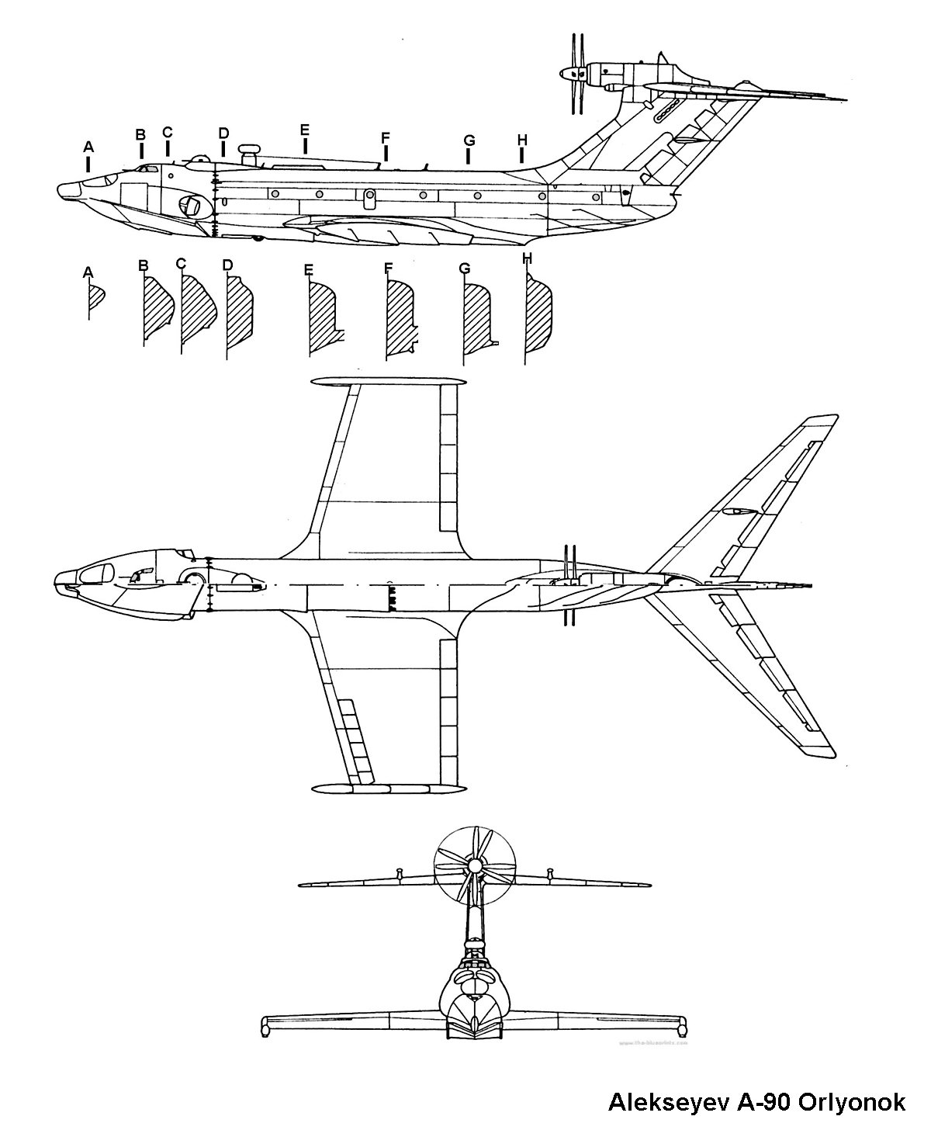
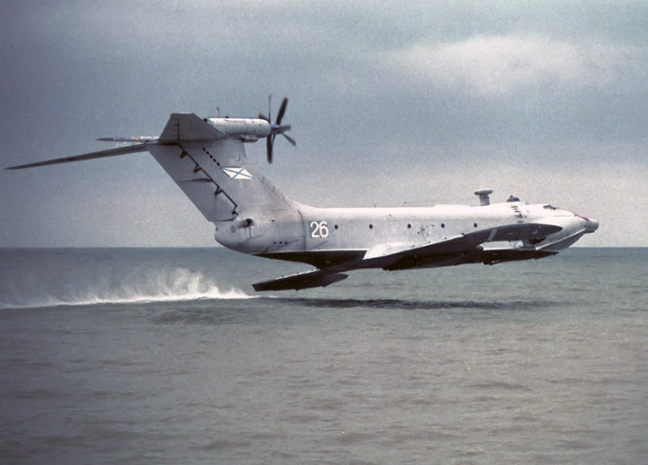
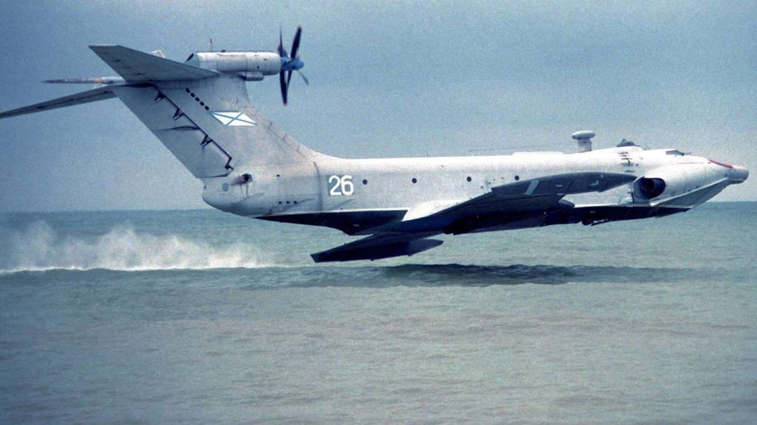
A-90 Orlynok (1972)
Notes:
Ground effect aircraft of the KM ekranoplan lineage, Alexeyev design

Slide 22
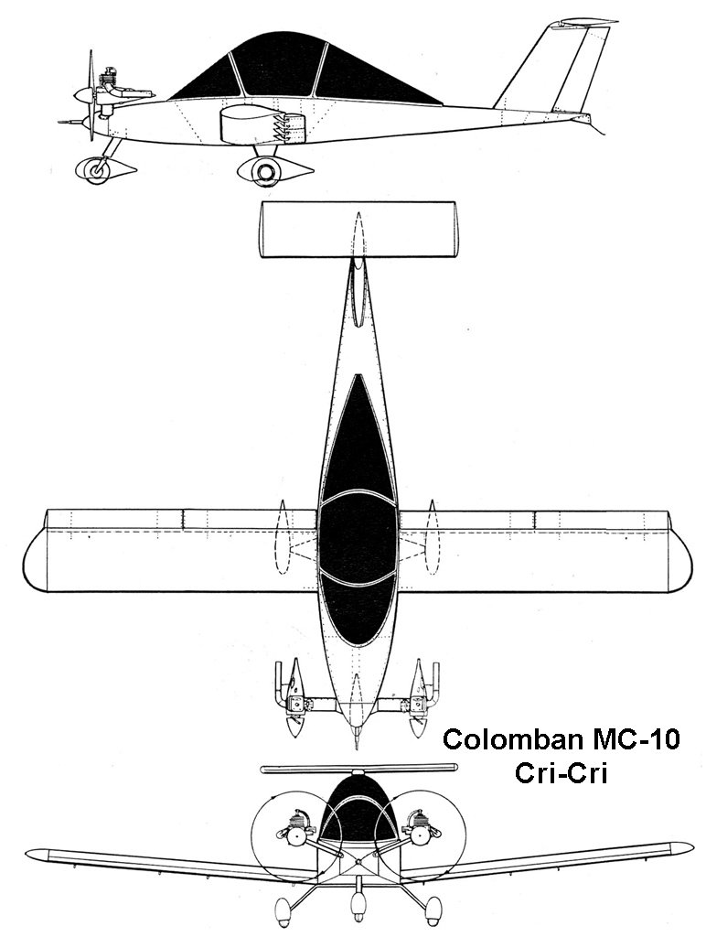
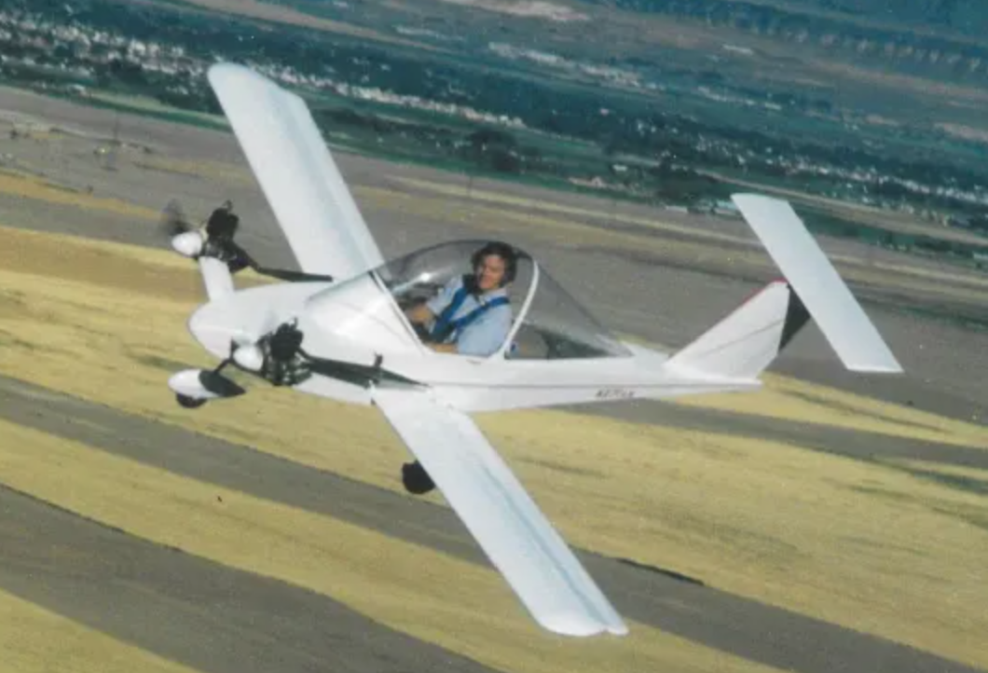
Colomban Cri-Cri (1973)

Slide 23
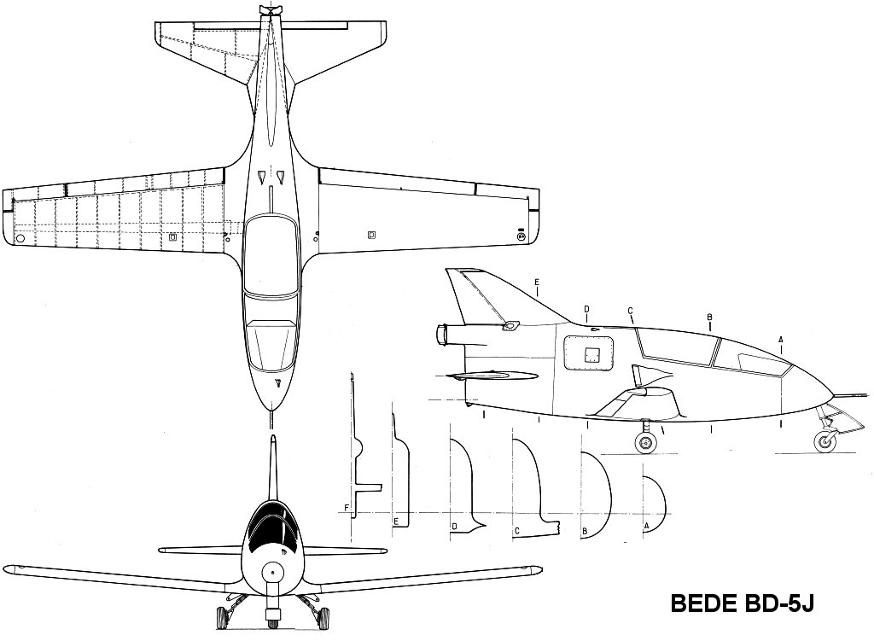
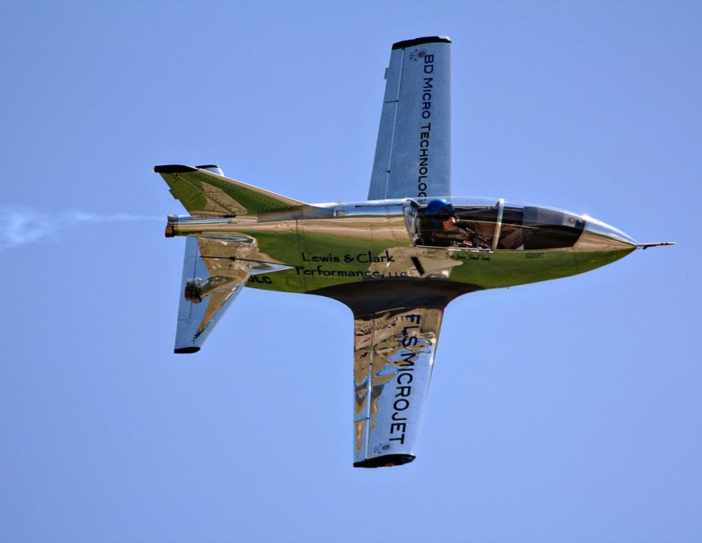
Bede BD-5J (1973)

Slide 24
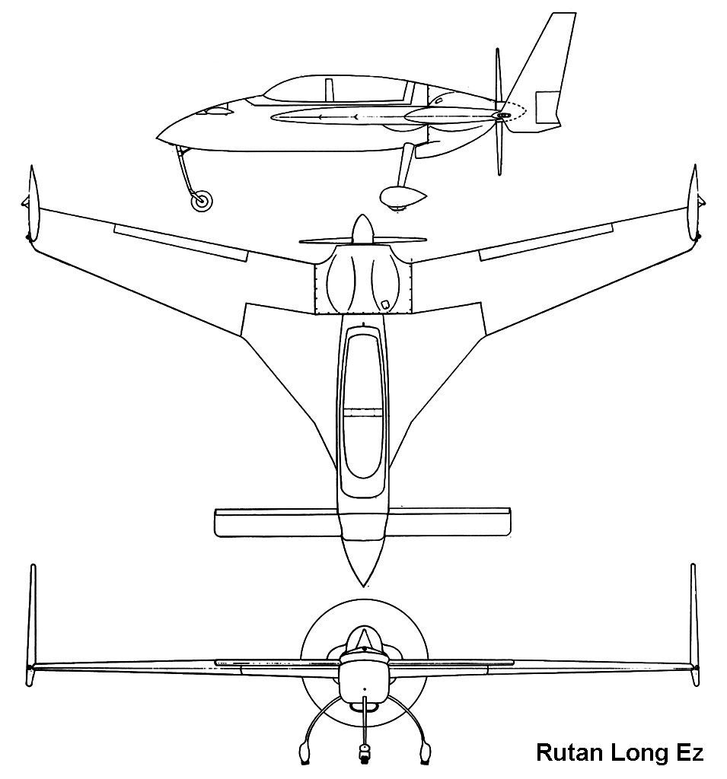
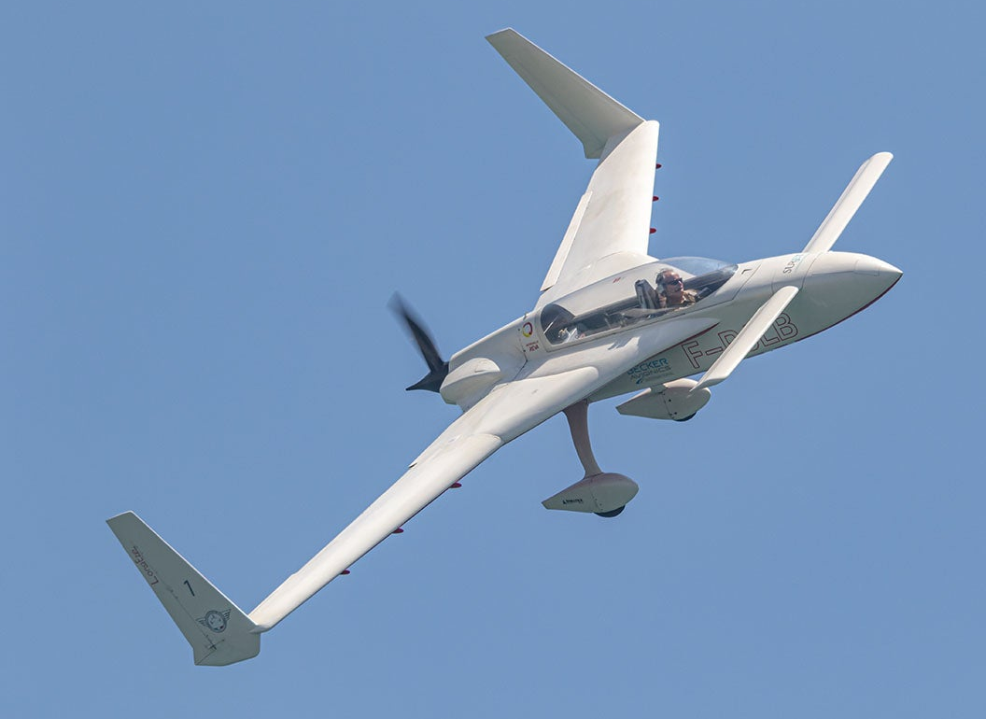
Rutan VariEze (1974)
Notes:
Long-Ez is a slightly larger version of Var-EZ (first flight 1979)

Slide 25
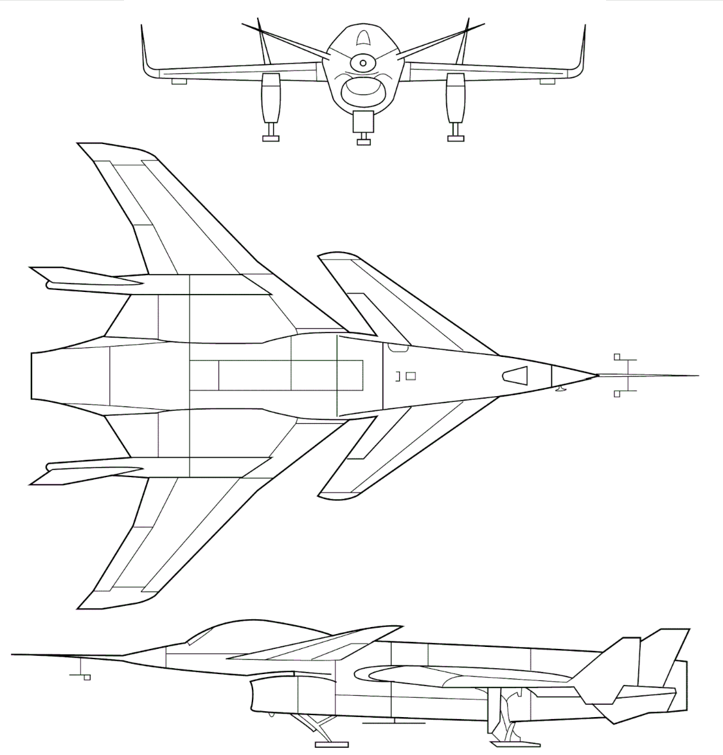
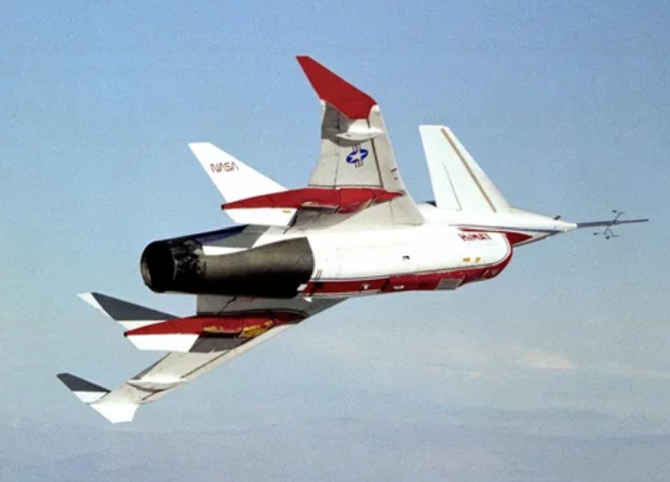
Rockwell HiMAT RRPV (1979)

Slide 26



General Dynamics F-16XL (1982)

Slide 27


Grumman X-29 (1984)

Slide 28


Ligeti Stratos (1985)

Slide 29


Beech 2000 Starship (1986)

Slide 30


McDonnell Douglas/NASA F-18 HARV (1987)
Notes:
High Alpha Research Vehicle!! Demonstrated capabilities included stable flight at approximately 70 degrees angle of attack (previous maximum was 55 degrees) and rolling at high rates at 65 degrees angle of attack. Controlled rolling would have been nearly impossible above 35 degrees without vectoring.

Slide 31


Northrop B-2 Spirit (1989)

Slide 32


McDonnell Douglas X-36 (1996)

Slide 33


Boeing X-32 (2000)

Slide 34




Slide 35





Slide 36
AIRCRAFT TO ADD:
D-21 drone
M-12 (maybe)
Should I do A-12 instead of SR-71?
TU-144 probably
KM/Caspian sea monster or other ekranoplans
Curtiss wright x-19

